Slide 1
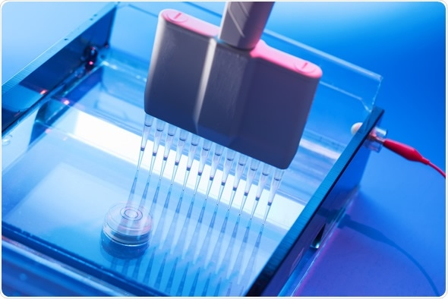
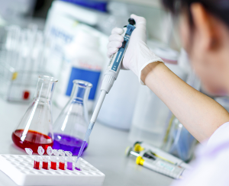
Gel Electrophoresis

Slide 2
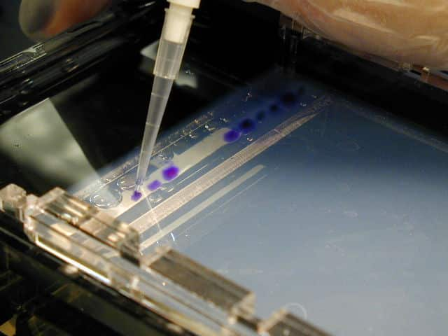
What is Gel Electrophoresis?
Gel Electrophoresis is a procedure for separating organic molecules by using an electric current through a gelatin like substance.
This can be used in forensics or to map DNA genes.

Slide 3
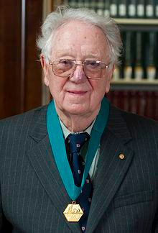
How was it discovered
A British geneticist in 1950, named Oliver Smithies created the process to help with his insulin studies.
He created a gel made out of potato starch and with old the electrophoresis method he compared blood samples

Slide 4
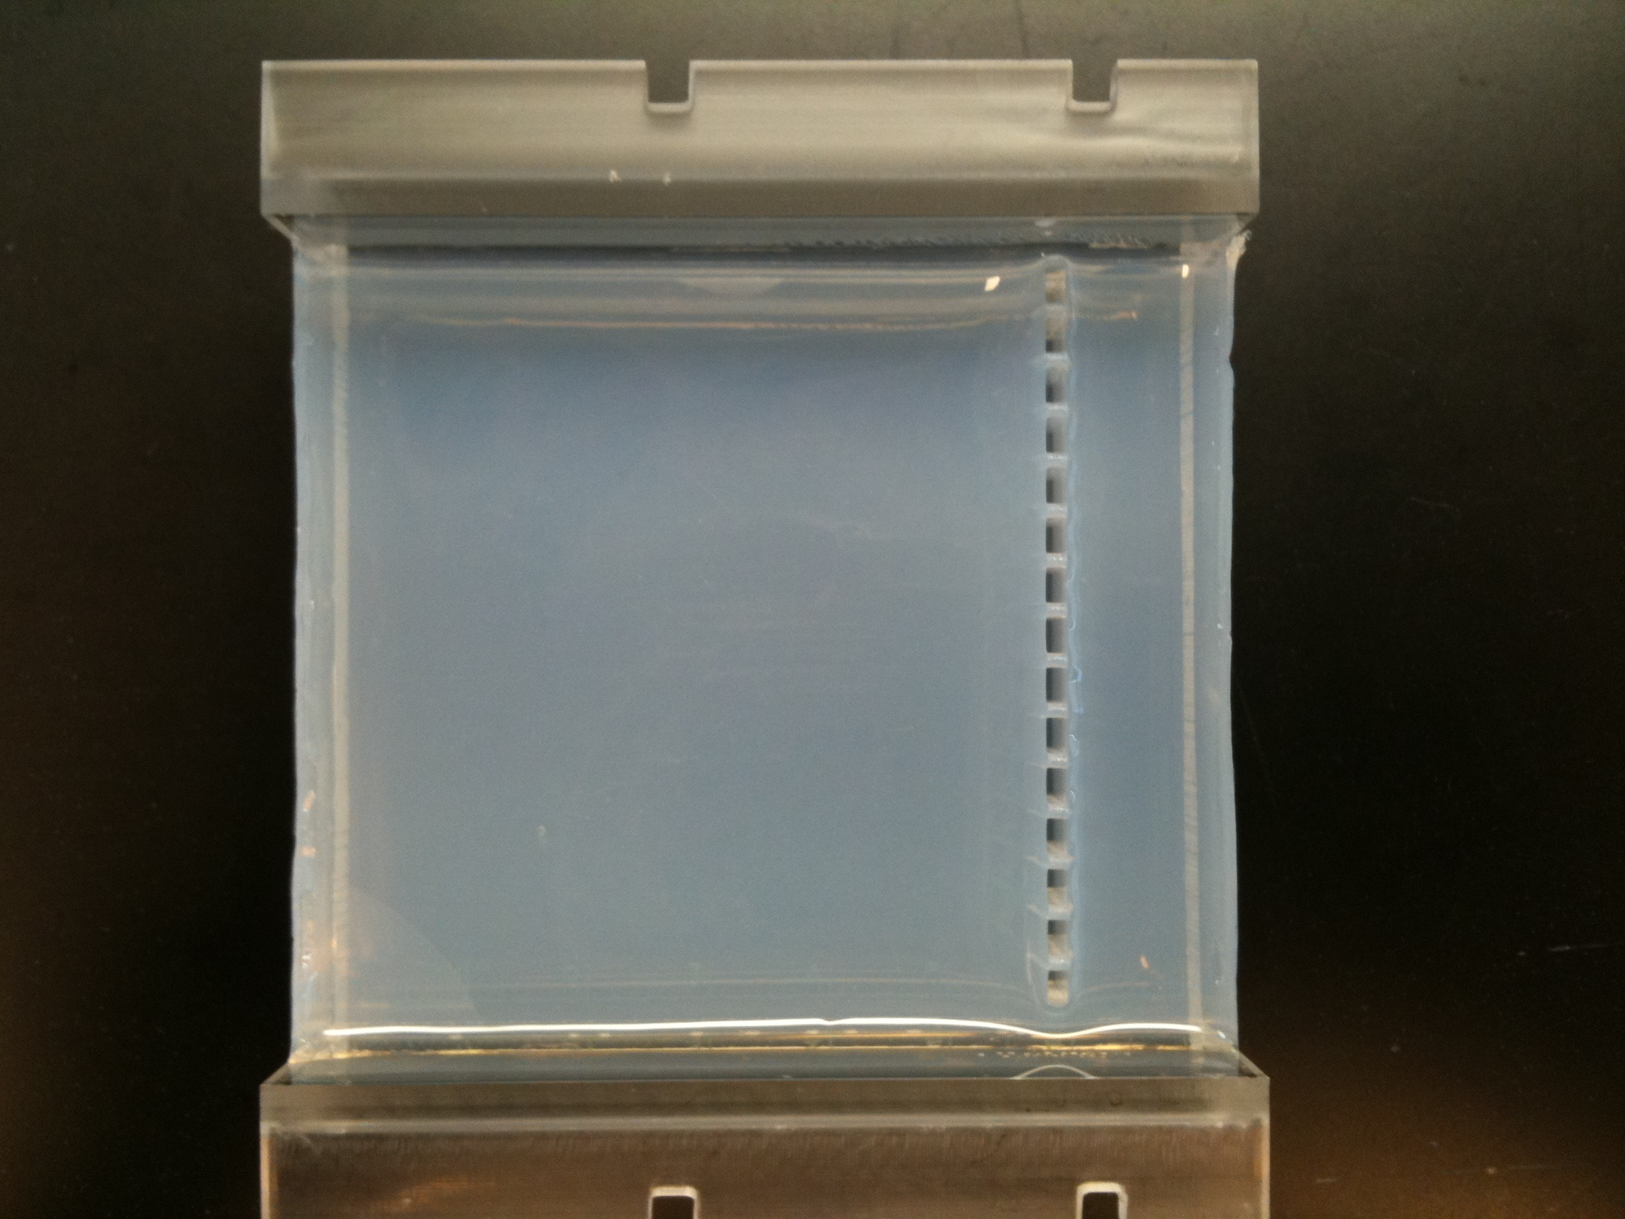
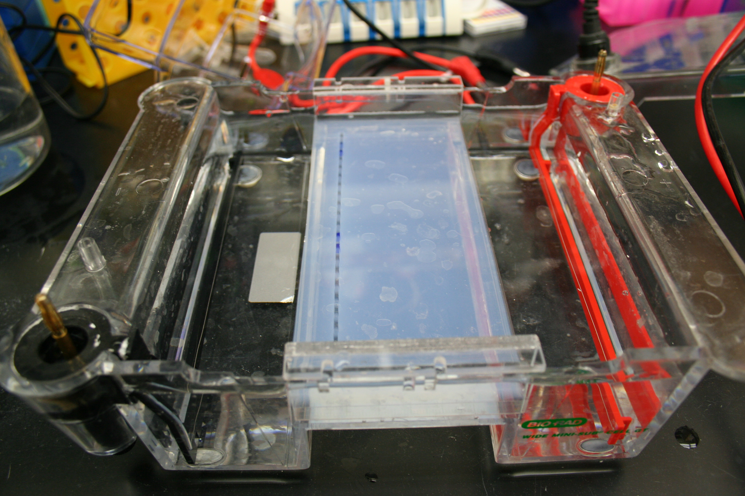
How to use Gel Electrophoresis
3. Move samples into the gel wells
4. Set the correct voltage and time then turn on chamber
Create Agarose gel
2. Place Gel into electrophoresis chamber with buffer solution

Slide 5
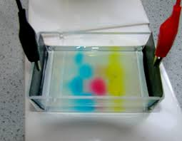
Final results
Compare each sample using the distance away from the wells (farther away=smaller molecules) and direction towards negative or positive charge.

