Slide 1
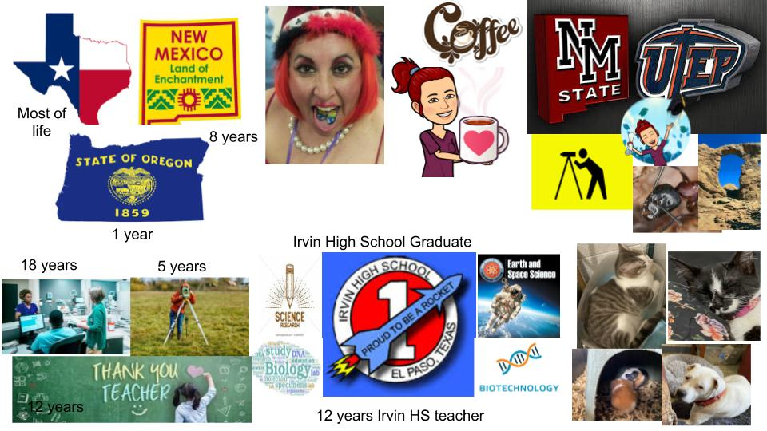
All about Me

Slide 2
What is your Full Name
Arlene Perez

Slide 3
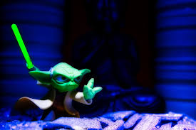
If you were a superhero what would your superpower be and why?
Magic is a force often relied upon by certain mystical characters. It is a very wide subject, and the uses of magic vary greatly from character to character. It is often used to simulate other powers, such as reality warping or mind control.
Why??? Mind control. You could control someone’s mind like a Jedi Night

Slide 4
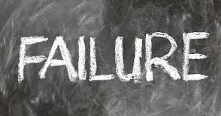
What is your greatest fear and why?
The meaning of Failure has changed through the years but I have never wanted to fail, so I pushed myself to try to be the best me possible.
Its okay to fail at things however, stopping because of fear of failing is failure.

Slide 5
What is your biggest accomplishment, explain?
Finishing my Engineering Degree
It was a difficult degree that I didn’t think I could do, but I did and I did it for myself

Slide 6
If you had a warning label what would yours say?

