Slide 1
6th period
Core value-safety

Slide 2
BE SAFE: Expectations for Halls & Stairways
Always have a Hall Pass and ID anytime you are out in the hall

Slide 3
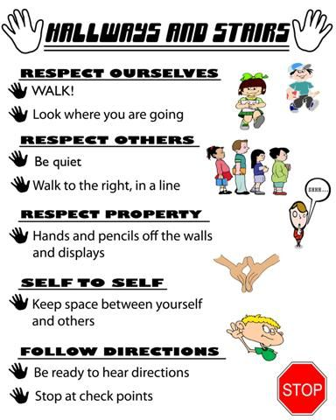

Slide 4
Classroom safety
If there is something wrong, what should you do?
Tell teacher immediately!
Indoor voices, No reason to yell
No food or drinks
No gum
No headphones
No horseplay
Bully free zone

Slide 5
Irvin Rockets Flight Plan 2019-2020
Irvin high school
Safety Drills

Slide 6
School Emergency Plans
Lockouts
Lockdown
Evacuate
Shelter

Slide 7
Lock Out Drill
Lockout is called when there is a threat or hazard outside of the school building.
Close doors and windows.
Teachers will keep students in the classroom.
No one can leave the classroom until it’s safe.
Teacher will continue with instruction.
Period is frozen during lock out.
Ignore bells.
Stay inside building at all times.
If outside building come inside.

Slide 8
Lock Down
Lockdown is called when there is a threat or hazard inside the school building.
Return to nearest classroom or office
Ignore all bells/alarms
Teacher will stop instruction
Lock doors, turn off lights, shut blinds and windows
Move away from windows and doors
All persons are to sit down against an interior wall
No talking or cell phone use
All cell phones should be turned off

Slide 9
Evacuate
Evacuate is called when there is a need to move students from one location to another.
The directives or actions may vary for fire, bomb threat, or other emergency.
Fire alarm is Automatic evacuation (unless were in a lock down)
Students will follow designated evacuation route (Tell students your route)
Close doors, turn off lights
Stay with class for easy account of students

Slide 10
Shelter
Shelter is called when specific protective actions are needed based on a threat or hazard, such as Severe weather, Wildfires, Flooding, tornado, earthquake or hazmat.
Move into designated safe areas such as inside rooms with no windows, bathrooms, utility closet, and hallway without large widows or doors.
Close classroom doors and windows when leaving
Kneel down and be ready to cover head to protect from debris

Slide 11
True or false Quiz
During a lock down, you may use your phone.
False!

Slide 12
During a lock down, you may talk quietly.
False! You must be silent.

Slide 13
During a lock out, you may not talk.
False! Teacher will continue with instruction

Slide 14
During a lock out, you may use the restroom, as long as it’s an emergency.
False! No one leaves the classroom during lock down and lock out.

Slide 15
During a fire drill you must evacuate immediately and go with your friends class.
False! You must stay with your own classmates.

Slide 16
After fire drill is over and It’s safe. you can walk around the school till you feel ready to go back to class.
False! You must go straight to class to ensure your safety.

Slide 17
During a lock down, it’s okay to use your cell phone as long as your texting and not talking.
False! Your cell phone must be turned off.

Slide 18
click here to watch a 5 minute video on what not to do during a fire drill (it's suppose to be funny)

